Slide 1
Dendogram

Slide 2
What is Dendogram :
Treat each observation as a individual cluster.
(1) Identify the two clusters that are closest together.
(2) Merge the two most similar clusters.

Slide 3
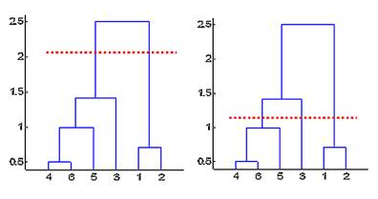
Specifying the cutting point :

Slide 4
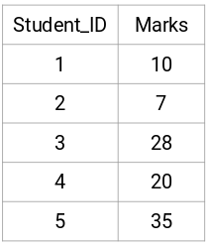
Example
Suppose a teacher wants to divide her students into different groups. She has the marks scored by each student in an assignment and based on these marks, she wants to segment them into groups. There’s no fixed target here as to how many groups to have.

Slide 5
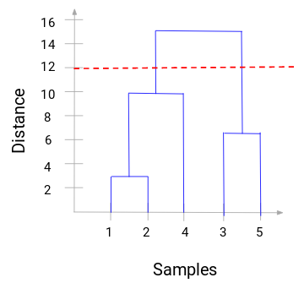
Dendrogram for the example :

Slide 6
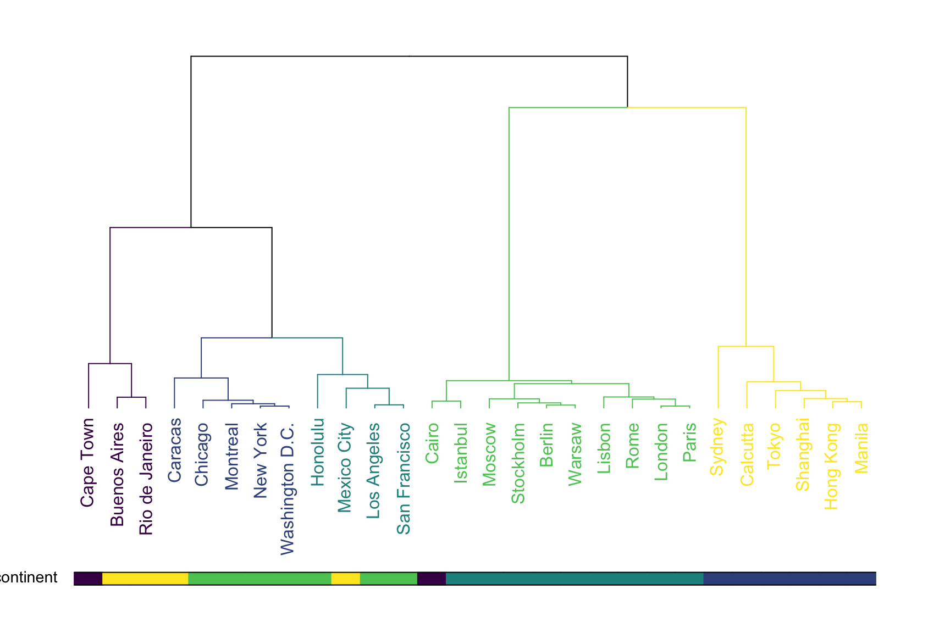
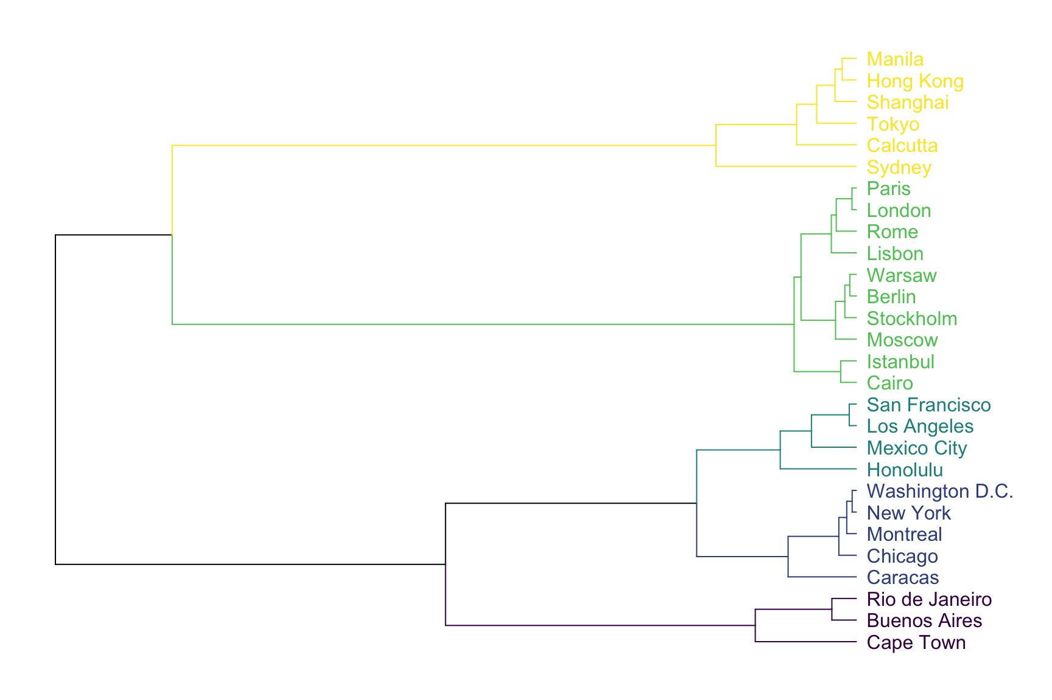
Variations :

Slide 7
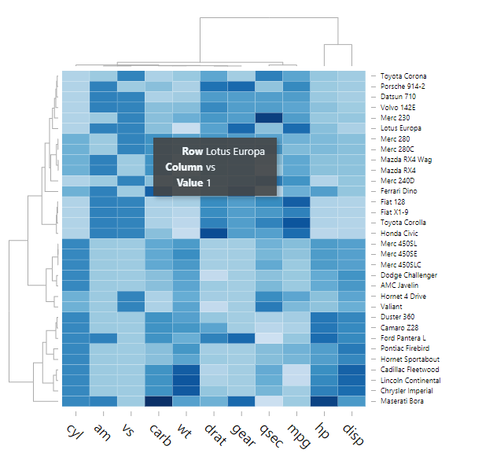
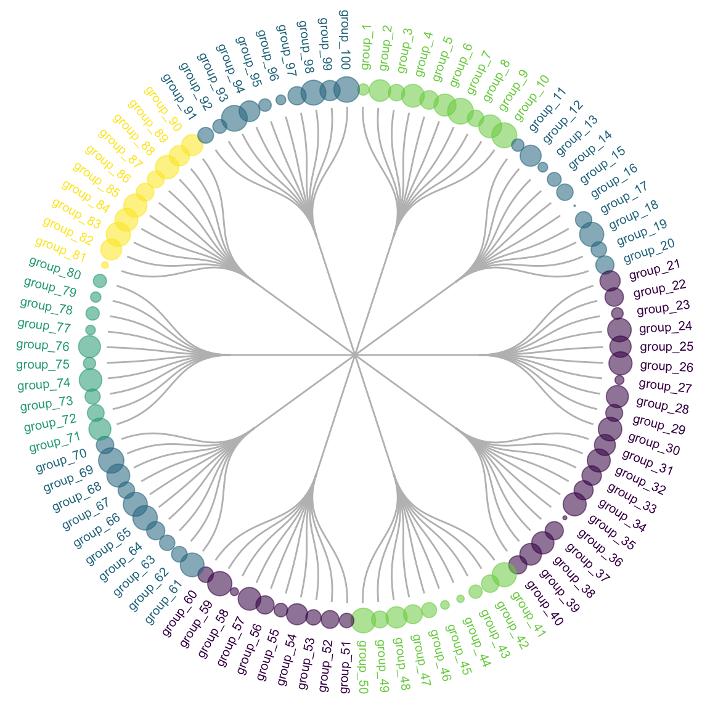
Cont..

Slide 8
Common mistakes :
If using a clustering algorithm, be sure you understood which metrics have been used for the distance calculation and for the clustering algorithm.
Horizontal version are appreciated with long labels
Showing the heatmap is a good practice if you’re working with clustering.

Slide 9
Dendogram visualization :
Dendogram with R : http://www.sthda.com/english/wiki/beautiful-dendrogram-visualizations-in-r-5-must-known-methods-unsupervised-machine-learning
Dendogram with python :https://plot.ly/python/dendrogram/
Excel : http://excelgraphs.blogspot.com/2013/04/plotting-dendogram-of-cluster-analysis.html

Slide 10


